Slide 1


WILT DATASET
DATA MINING PROJECT
Guruvikas Reddy Busa -700703380
Vamshi Pillamari -700705475
Medha Vijayvargia - 700703734
INSTRUCTOR
LIANWEN WANG

Slide 2

Introduction to Wilt Dataset
When you leave for work in the morning and your plant looks perfectly happy, but by the time you come home, it’s pitiful and droopy. So why do plants wilt? The imbalance in the water content of the plant cells results in the wilt of plant.The main purpose of the project is to predict the plant state (wilt and not wilt) based on the attributes in the dataset obtained from Quickbird multispectral image bands and texture information from the panchromatic (Pan) image band.

Slide 3
Problem statement
Identify whether a plant is wilt or not
Dataset: Consists of wilt as well as not wilt plants along with their different features

Slide 4
Dataset
This dataset contains six variables and 4839 instances.
Training set contains 3387 instances (70% of data) and Testing set contains 1452 instances (30% of data).
All the variables in this dataset are numerical except the class variable.
There are NO MISSING VALUES in this dataset.

Slide 5
Attribute Information
class: 'w' (diseased trees), 'n' (all other land cover)
GLCM_Pan: GLCM mean texture (Pan band)
Mean_G: Mean green value
Mean_R: Mean red value
Mean_NIR: Mean NIR value
SD_Pan: Standard deviation (Pan band)

Slide 6
Decision Tree
Decision Tree is a very popular machine learning algorithm which solves the problem of machine learning by transforming the data into tree representation
It can be used to solve both regression and classification problems.
They build an actual decision tree on the data set
Decision trees perform classification without requiring much computation.

Slide 7
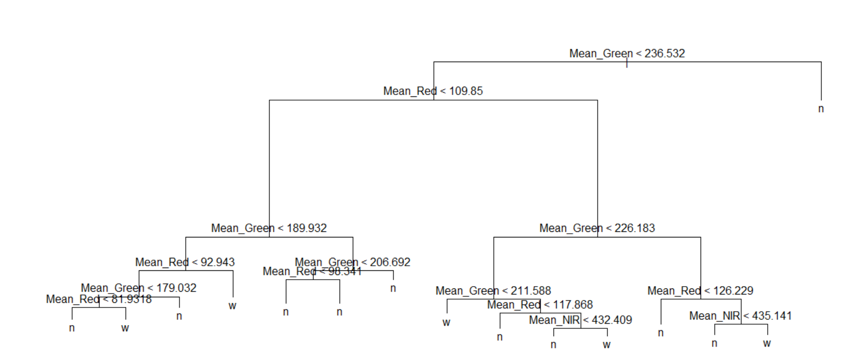

Slide 8
Hold Out Method
Hold-out is when you split up the dataset into a ‘train’ and ‘test’ set. The training set is what the model is trained on, and the test set is used to see how well that model performs on unseen data. A common split when using the hold-out method is using 70% of data for training and the remaining 30% of the data for testing.
Training Accuracy: 98.99616
Training Error: 1.003838
Testing Accuracy: 97.72727
Testing error: 2.272727

Slide 9
Bagging
It is a bootstrap ensemble method that combines the predictions from multiple machine learning algorithms together to make more accurate predictions than any individual model.
Each classifier’s training set is generated by randomly drawing, with replacement
It reduces variance and helps to avoid overfitting
Training Accuracy: 100
Training Error: 0
Testing Accuracy: 98.27824
Testing error: 1.721763

Slide 10
Random Forest
Random Forest builds multiple decision trees and merges them together to get a more accurate and stable prediction.
The random forest is a classification algorithm consisting of many decisions trees.
Training Accuracy: 100
Training Error: 0
Testing Accuracy: 100
Testing Error: 0

Slide 11
Boosting
It is an ensemble method for improving the model predictions of any given learning algorithm
The idea of boosting is to train weak learners sequentially, each trying to correct its predecessor.
Test Error Rate: 100

Slide 12
Naïve Bayes Classifier
It is a classification technique based on Bayes’ Theorem with an assumption of independence among predictors
It is fast classification algorithm, which is suitable for a large chunk of data.
Training Accuracy: 89.78447
Training Error: 10.21553
Testing Accuracy: 90.63361
Testing error: 9.366391

Slide 13
Support Vector Machine using Linear Kernel with different costs(best case)
SVM is a supervised learning algorithm that can be used for both classification and regression challenges.
Training Accuracy: 96.75229
Training Error: 3.247712
Testing Accuracy: 97.03857
Testing error: 2.961433

Slide 14
Support Vector Machine using Radial Kernel with different costs and gammas(best case)
Training Accuracy: 99.17331
Training Error: 0.8266903
Testing Accuracy: 98.62259
Testing error: 1.37741

Slide 15
Support Vector Machine using Polynomial Kernel with different costs and gammas(best case)
Training Accuracy: 98.25805
Training Error: 1.741955
Testing Accuracy: 98.62259
Testing error: 1.37741

Slide 16

Comparison of multiple classification techniques
Classification Method | Training Accuracy | Training Error | Testing Accuracy | Testing Error
Holdout Method | 98.34662 | 1.653381 | 97.79614 | 2.203817
Bagging | 100 | 0 | 98.62259 | 1.37741
Random Forest | 100 | 0 | 100 | 0
Naïve Base | 90.37496 | 9.625037 | 89.73829 | 10.26171
SVM Linear | 96.87039 | 3.129613 | 96.76309 | 3.236915
SVM Radial | 99.20283 | 0.7971656 | 98.69146 | 1.30854
SVM Polynomial | 98.13995 | 1.860053 | 98.69146 | 1.30854

Slide 17
Conclusion
In this project, we have performed many classification techniques such as Decision tree hold out, Random forest, Bagging, Naïve Bayes and Support vector machine. We have analyzed the accuracy and error rates obtained from the techniques. Among all the techniques Random Forest, Holdout and Bagging methods are the best classification for our data set which provide error rate less than 2.3% and accuracy greater than 97.7% when compared to other classifiers

Slide 18
Future scope
We would like to implement our study in the Gardening/Agriculture based on cloud integrated with IOT’s that would fetch real-time data, a continuous evaluation is conducted on plant status based on the analysis of input data and water is passed to the plant based on the status of the plant thereby saving water resources and protecting the crop health.

Slide 19
References
https://archive.ics.uci.edu/ml/datasets/Wilt
https://towardsdatascience.com/ensemble-methods-bagging-boosting-and-stacking-c9214a10a205
https://medium.com/greyatom/decision-trees-a-simple-way-to-visualize-a-decision-dc506a403aeb
https://towardsdatascience.com/support-vector-machine-introduction-to-machine-learning-algorithms-934a444fca47
https://towardsdatascience.com/naive-bayes-in-machine-learning-f49cc8f831b4
https://medium.com/@eijaz/holdout-vs-cross-validation-in-machine-learning-7637112d3f8f

Slide 20

THANK YOU

